Slide 1
UNIT 2A
RIGHT PLACE - WRONG PERSON
2. READING AND SPEAKING
Page 15
TEACHER’S NAME: VO THI HONG LAN

Slide 2
READ IN PAIRS
STUDENT A
STUDENT B
JOE’S VACATION
LAURA’S VACATION

Slide 3
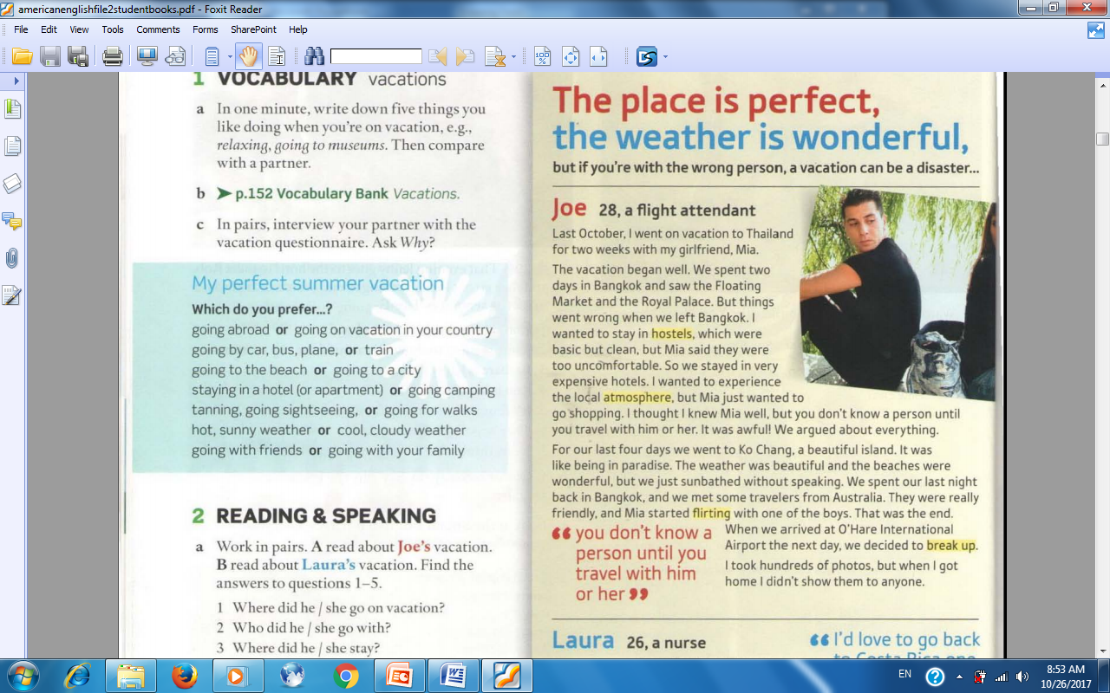
LISTEN TO
THE TAPE
STUDENT A
JOE’S VACATION

Slide 4
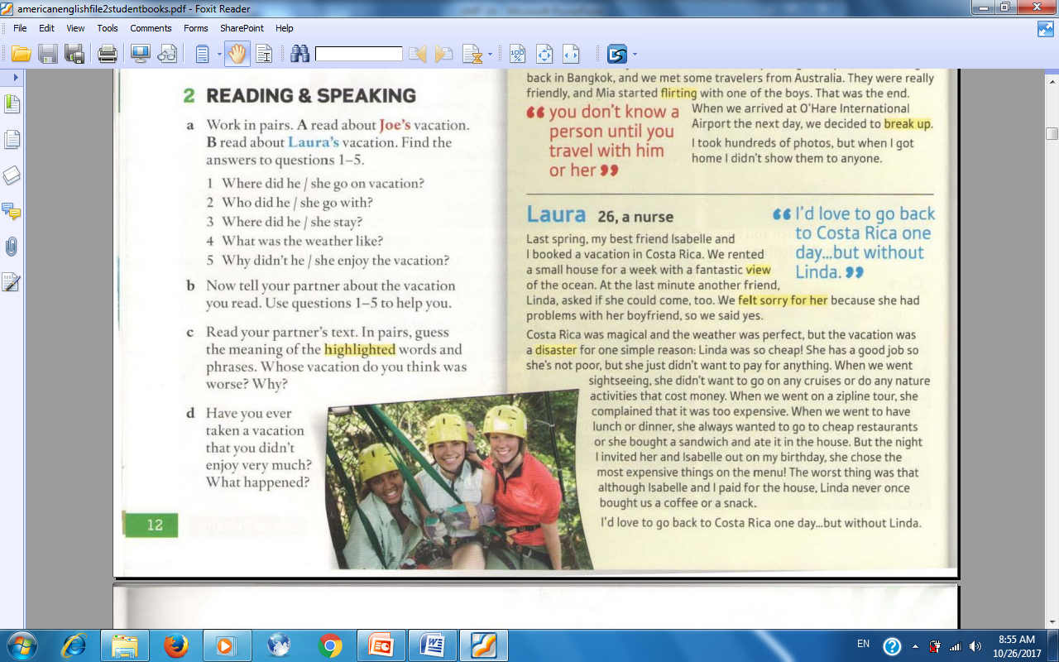
LISTEN TO
THE TAPE
STUDENT B
LAURA’S VACATION

Slide 5
I. FILL IN THE TABLE ABOUT JOE’S VACATION.
STUDENT A
COUNTRY? | GO WITH? | STAY IN? | WEATHER? | WHY NOT ENJOY?
THAILAND

Slide 6
I. FILL IN THE TABLE ABOUT JOE’S VACATION.
STUDENT A
COUNTRY? | GO WITH? | STAY IN? | WEATHER? | WHY NOT ENJOY?
THAILAND
GIRLFRIEND

Slide 7
I. FILL IN THE TABLE ABOUT JOE’S VACATION.
STUDENT A
COUNTRY? | GO WITH? | STAY IN? | WEATHER? | WHY NOT ENJOY?
THAILAND
GIRLFRIEND
EXPENSIVE HOTELS

Slide 8
I. FILL IN THE TABLE ABOUT JOE’S VACATION.
STUDENT A
COUNTRY? | GO WITH? | STAY IN? | WEATHER? | WHY NOT ENJOY?
THAILAND
GIRLFRIEND
EXPENSIVE HOTELS
BEAUTIFUL

Slide 9
I. FILL IN THE TABLE ABOUT JOE’S VACATION.
STUDENT A
COUNTRY? | GO WITH? | STAY IN? | WEATHER? | WHY NOT ENJOY?
THAILAND
GIRLFRIEND
EXPENSIVE HOTELS
BEAUTIFUL
NOT KNOW MIA WELL

Slide 10
I. FILL IN THE TABLE ABOUT LAURA’S VACATION.
STUDENT B
COUNTRY? | GO WITH? | STAY IN? | WEATHER? | WHY NOT ENJOY?
COSTA RICA

Slide 11
III. FILL IN THE TABLE ABOUT LAURA’S VACATION.
STUDENT B
COUNTRY? | GO WITH? | STAY IN? | WEATHER? | WHY NOT ENJOY?
COSTA RICA
2 FRIENDS

Slide 12
III. FILL IN THE TABLE ABOUT LAURA’S VACATION.
STUDENT B
COUNTRY? | GO WITH? | STAY IN? | WEATHER? | WHY NOT ENJOY?
COSTA RICA
2 FRIENDS
SMALL HOUSE

Slide 13
III. FILL IN THE TABLE ABOUT LAURA’S VACATION.
STUDENT B
COUNTRY? | GO WITH? | STAY IN? | WEATHER? | WHY NOT ENJOY?
COSTA RICA
2 FRIENDS
SMALL HOUSE
PERFECT

Slide 14
III. FILL IN THE TABLE ABOUT LAURA’S VACATION.
STUDENT B
COUNTRY? | GO WITH? | STAY IN? | WEATHER? | WHY NOT ENJOY?
COSTA RICA
2 FRIENDS
SMALL HOUSE
PERFECT
LINDA WAS CHEAP.

Slide 15
II. ANSWER THE QUESTIONS
ABOUT JOE’S VACATION.
STUDENT A
1.Where did Joe go on vacation?
2. Who did he go with?
3. Where did he stay?
4. What was the weather like?
5. Why didn’t he enjoy the vacation?
He went to Thailand.
He went with his girlfriend, Mia.
He stayed in expensive hotels.
The weather was beautiful.
Because he didn’t know Mia well.

Slide 16
II. ANSWER THE QUESTIONS
ABOUT LAURA’S VACATION.
STUDENT B
1.Where did Laura go on vacation?
2. Who did she go with?
3. Where did she stay?
4. What was the weather like?
5. Why didn’t she enjoy the vacation?
She went to Costa Rica.
She went with 2 friends.
She stayed in a small house.
The weather was perfect.
Because Linda was so cheap.

Slide 17
III. WORK IN PAIRS (SPEAKING)
STUDENT A
STUDENT B
JOE’S VACATION
LAURA’S VACATION
USE THE ANSWERS ABOVE

Slide 18
SPEAKING
STUDENT A
JOE’S VACATION

Slide 19
SPEAKING
STUDENT B
LAURA’S VACATION

Slide 20
IV. READ IN PAIRS
STUDENT A
STUDENT B
JOE’S VACATION
LAURA’S VACATION
GUESS THE MEANING OF THE HIGHLIGHTED WORDS AND PHRASES

Slide 21
GUESS THE MEANING OF THE HIGHLIGHTED WORDS AND PHRASES

Slide 22
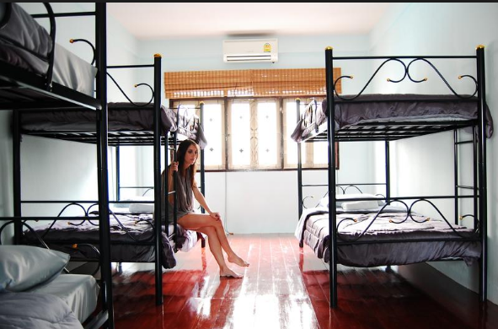
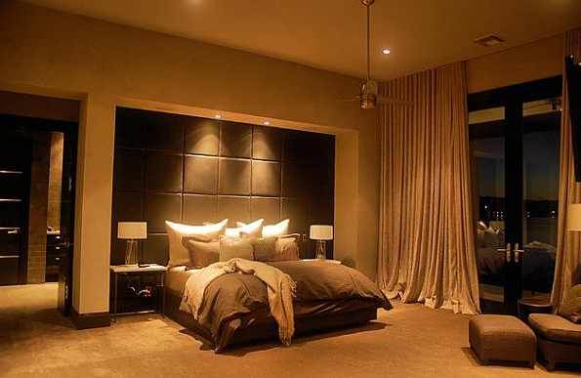
HOSTEL
HOTEL

Slide 23
GUESS THE MEANING OF THE HIGHLIGHTED WORDS AND PHRASES
HOSTEL
NHÀ TRỌ RẺ TIỀN

Slide 24
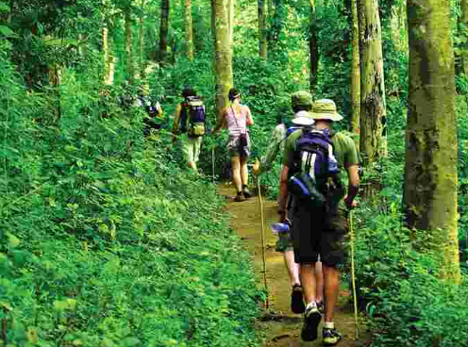
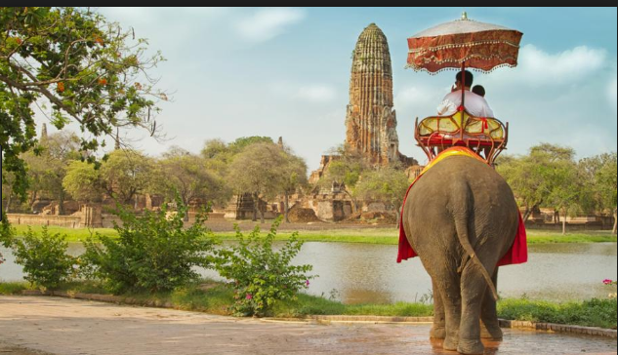
LOCAL ATMOSPHERE

Slide 25
GUESS THE MEANING OF THE HIGHLIGHTED WORDS AND PHRASES
HOSTEL
NHÀ TRỌ RẺ TIỀN
ATMOSPHERE
KHÔNG KHÍ

Slide 26
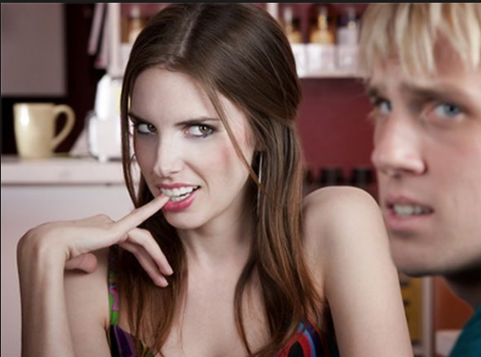
FLIRTING

Slide 27
GUESS THE MEANING OF THE HIGHLIGHTED WORDS AND PHRASES
HOSTEL
NHÀ TRỌ RẺ TIỀN
ATMOSPHERE
KHÔNG KHÍ
FLIRTING
TÁN TỈNH

Slide 28
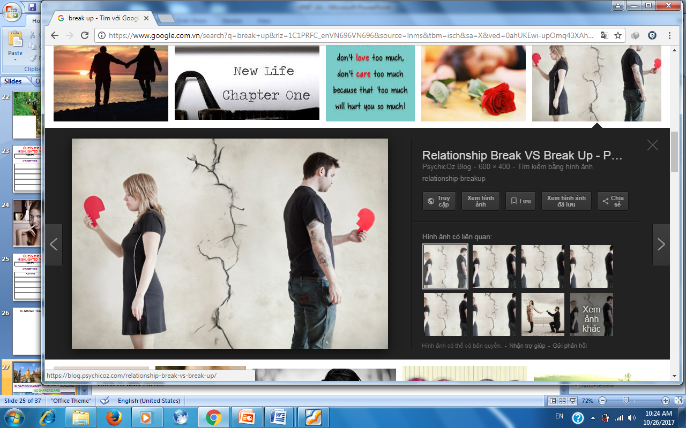
BREAK UP

Slide 29
GUESS THE MEANING OF THE HIGHLIGHTED WORDS AND PHRASES
HOSTEL
NHÀ TRỌ RẺ TIỀN
ATMOSPHERE
KHÔNG KHÍ
FLIRTING
TÁN TỈNH
BREAK UP
CHIA TAY

Slide 30
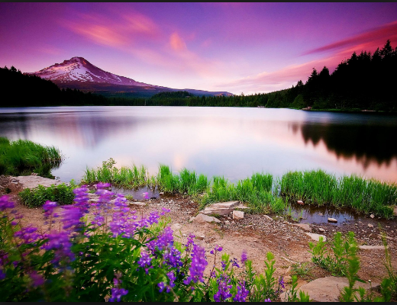
FANTASTIC VIEW

Slide 31
GUESS THE MEANING OF THE HIGHLIGHTED WORDS AND PHRASES
HOSTEL
NHÀ TRỌ RẺ TIỀN
ATMOSPHERE
KHÔNG KHÍ
FLIRTING
TÁN TỈNH
BREAK UP
CHIA TAY
VIEW
QUANG CẢNH

Slide 32
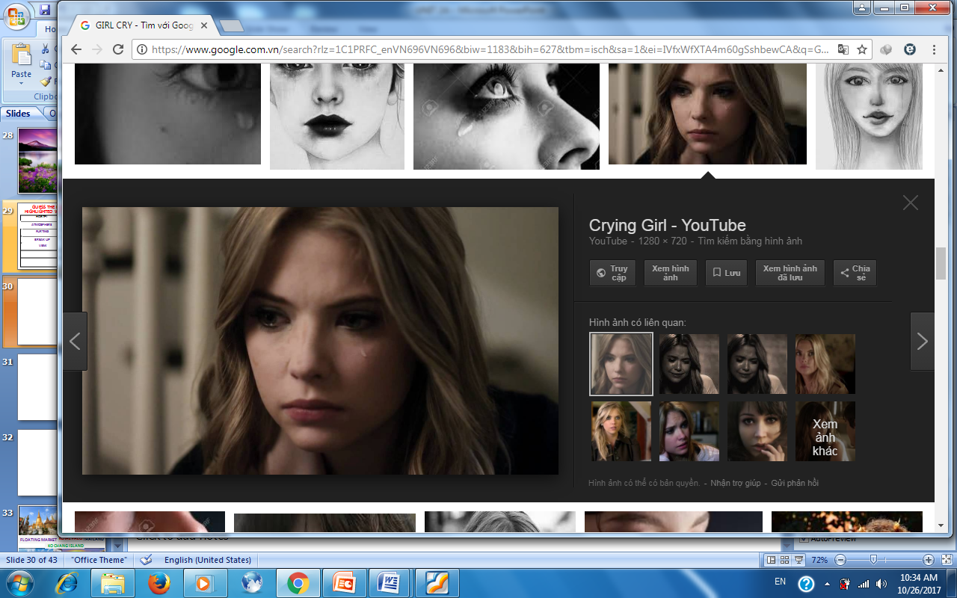
FELT SORRY FOR HER

Slide 33
GUESS THE MEANING OF THE HIGHLIGHTED WORDS AND PHRASES
HOSTEL
NHÀ TRỌ RẺ TIỀN
ATMOSPHERE
KHÔNG KHÍ
FLIRTING
TÁN TỈNH
BREAK UP
CHIA TAY
VIEW
QUANG CẢNH
FELT SORRY FOR HER
CẢM THẤY TỘI NGHIỆP CÔ ẤY

Slide 34
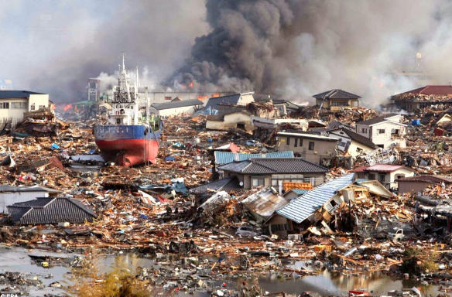
NATURAL DISASTER

Slide 35
GUESS THE MEANING OF THE HIGHLIGHTED WORDS AND PHRASES
HOSTEL
NHÀ TRỌ RẺ TIỀN
ATMOSPHERE
KHÔNG KHÍ
FLIRTING
TÁN TỈNH
BREAK UP
CHIA TAY
VIEW
QUANG CẢNH
FELT SORRY FOR HER
CẢM THẤY TỘI NGHIỆP CÔ ẤY
DISASTER
THẢM HOẠ

Slide 36
V. SPEAKING
1. WHOSE VACATION DO YOU THINK WAS WORSE? WHY?
BREAK UP

Slide 37
V. SPEAKING
2. WHERE DID YOU GO ON VACATION?
3. WHO DID YOU GO WITH?
4. WHERE DID YOU STAY?
5. WHAT WAS THE WEATHER LIKE?
6. HOW DID YOU FEEL?

Slide 38
THANKS FOR YOUR ATTENTION!

